Slide 1





Unlock more business potential with Microsoft 365 Copilot
Use this PowerPoint deck as a template to create a custom static eBook for your brand by adding your logo, fonts, colors, and content.
Yellow highlights in the template indicate the areas where text or graphics should be customized for your brand.
1
Customize your brand fonts and colors in the Slide Master
2
Update the yellow-highlighted text with your brand-specific copy. Match the surrounding type color by removing the yellow highlight treatment. Adjust the size and display of your fonts to fit the template
3
Add your custom logo
4
Replace template stock photography with your own custom images if desired.
5
Save your final art. Name your file
and choose the file destination.
Delete the off-slide instructions and any remaining highlighting and use
the File pulldown menu to select Export to save as a PDF.

Slide 2

Introduction
80%
Over the last several years, growing businesses report that work has accelerated faster than their employees’ ability to keep up.
68%
Of people say they struggle with the pace and volume of work; 46% feel burnt out.¹
67%
Of small to medium-sized businesses (SMBs) struggle with being innovative or thinking strategically.¹
These trends have led to 80% of employees bringing their own AI to work.¹ However, businesses need a cohesive AI platform that supports their entire business to get the most value and can protect their sensitive data.
71%
Of SMBs lack the energy to complete their day-to-day work, while more than half need more focus time.¹
61%
Of SMBs believe they spend too much time searching for the right data or information when needed.¹
1. “2024 Work Trend Index Annual Report,” Microsoft, 2024.
2
BACK
NEXT

Slide 3

Empower your employees with the AI assistant for work: Microsoft 365 Copilot
Microsoft 365 Copilot boosts productivity and creativity, helping you unlock more value and opportunity for your business.
As your AI assistant for work, it automates business processes across functions, including sales, marketing, human resources (HR), legal, finance, and customer service* As a result, you and your team can focus on growing your business and scaling securely while staying in control of your business data.
Realize the benefits
Of SMB users say that Microsoft 365 Copilot meets or exceeds their expectations.²
76%
In this e-book, we will look at how [partner name] can help you realize the benefits of Microsoft 365 Copilot, Copilot Chat, and agents across:
Sales
Marketing
Human resources
Customer service
Of SMB users utilize Microsoft 365 Copilot to summarize content—from emails and slides, to data and chats.²
63%
Of SMB users say that Microsoft 365 Copilot helps them achieve a good first draft quicker.²
*For more information on how Microsoft 365 Copilot can support your finance and legal departments,
please contact our team.
2. SMB Copilot for Microsoft 365: Early Adopter Insights by Research + Insights Hyper Targeted Research Platform.
62%
3
BACK
NEXT

Slide 4






Introducing Copilot Chat and agents
Copilot Chat
Growing businesses need the opportunity to test different AI use cases before fully investing in solutions that may not fit their needs. Microsoft understands this and has now released Copilot Chat to give every organization the opportunity to test next-generation AI for specific business use cases.
Copilot Chat is a free and secure AI chat solution that gives your employees at your growing business a standardized AI experience as you implement transformational strategies.
Agents
Using prebuilt agents or creating agents with Copilot Studio is another way that you can reimagine critical business processes that support your employees, teams, and entire organization.
With agents, users can:
  Automate workflows like submitting expenses, hiring processes, and updating benefits information.
  Complete tasks by prompting agents using connectors, workflows, custom topics, and AI prompts.
Additionally, agents do not require users to be technical experts. Agents can be securely created and published directly in the Microsoft 365 apps your employees use the most often with access only given to specific users or groups.
Users have access to:
    Free, secure AI chat powered by GPT-4o so they can complete market research, draft documents, prepare for meetings, upload files, and collaborate across teams.
    Agents that are accessible right in the chat. Using natural language, users can easily create agents that automate repetitive tasks and business processes.
    IT controls, including enterprise data protection and agent management.
Provide your employees with foundational AI functionality and opportunities to familiarize themselves with prompting best practices as you identify additional scenarios where Copilot can improve processes for your organization.
4
BACK
NEXT

Slide 5


The top Copilot prompts to start exploring
1. Create a to-do list
Input your tasks into Copilot and let it create a prioritized to-do list.
6. Create a presentation
Develop a designed presentation with speaker notes in just a few clicks.
2. Draft email
Personalize the tone and length.
7. Summarize a document
Get right down to business by summarizing long documents and focusing on the relevant sections.
As you prepare your organization to embrace AI innovation, you can encourage your team to build their AI skills with Copilot Chat without anchoring it in your business’ data at copilot.microsoft.com. Here are the top ten ways your employees can develop their foundational Copilot skills.
3. Tell me about a topic or project
Provide insights and analysis from web sources to get up to speed quickly.
8. Give me some ideas for…
Boost your creativity with ideas for your work such as agendas, product names, social media posts, etc.
4. Help me write…
Jumpstart creativity and write and edit like a pro by getting a first draft in seconds.
9. What did they say…
When you vaguely remember someone mentioning a topic, have Copilot do the research.
5. Revise this content
When you’ve got a rough draft of an idea, turn it into usable text and then vary the length and tone.
10. Translate a message
With business becoming increasingly international, it’s important to be able to read or write messages in other languages.
5
BACK
NEXT

Slide 6
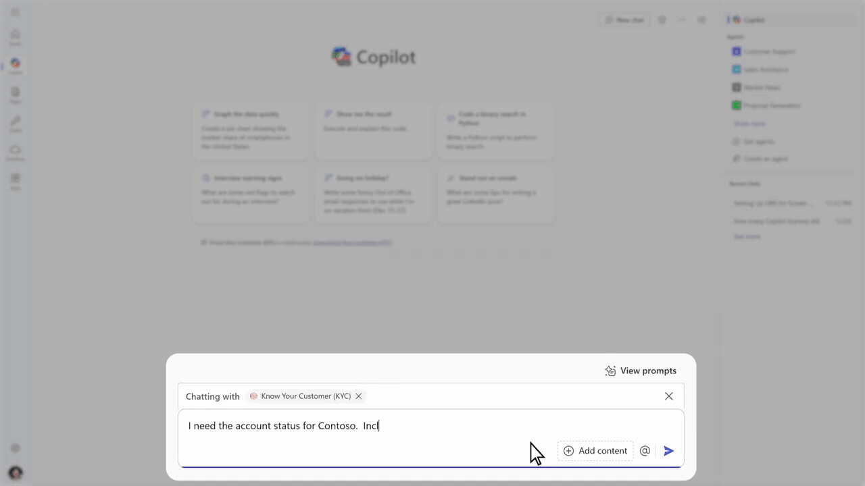



Sales
Sellers at agile businesses need the ability to focus on building their pipelines and closing deals to support business growth. On average, sales reps spend an average of 440 hours annually trying to find the right content to share with their prospects and customers ^{3.} To free up this time, they need a solution that can streamline manual tasks and provide better insights to push deals over the finish line.
Microsoft 365 Copilot and Copilot Chat work alongside sales teams to handle administrative and repetitive tasks, from conducting industry research to creating personalized proposals. As a result, sales professionals save time and focus on building stronger relationships, enhancing their pipeline, and closing deals.
Create more opportunities
Better prepare for discovery sessions with an agent that drafts tailored questions and content.
Increase deal size
  Use Copilot to generate charts and presentation content using the customer’s data to help close more high-value deals.
Improve win/close rate
  Give the customer your full attention in the meeting while Copilot takes notes. Prompt Copilot to use those notes to focus on the most important information and create targeted offers when drafting the proposal.
Improve customer retention
  Maintain strong customer relationships post-sales by using Copilot to generate personalized communications, share customer data with service departments, and perform sentiment analysis to address issues quickly.
Examples Microsoft 365 Copilot prompts for sales:
Copilot, I need the account status for Contoso. Include a general overview, the number of licenses, and account value.
Help me prepare for the product demonstration this afternoon.
How’s my pipeline looking compared to my monthly targets?
Outcome
  Increased revenue with more sales closed
3. “70+ Sales Enablement Statistics To Blow Your Mind in 2024,” G2, 2024.
6
BACK
NEXT

Slide 7
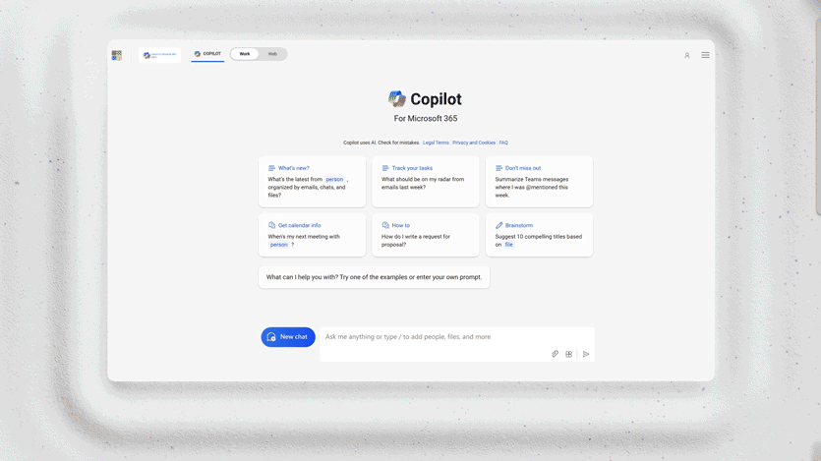
Marketing
Growing marketing teams handle multiple responsibilities while trying to hit aggressive goals to support company growth. Microsoft 365 Copilot streamlines developing strategic marketing plans, collaborating with other teams, and composing copy so marketers can focus on turning ideas into qualified revenue opportunities.
Increased leads generated
Use Copilot to perform market research, discover trends, and identify the markets with the most opportunities to target with tailored competitive offerings and content.
Reduce agency spend
Optimize budget spending, bringing previously outsourced work in-house by quickly generating high-quality, tailored content with Copilot.
Improve customer retention
Support customers post-sale with Copilot-generated content that speaks to their industry, users, and goals as they use the product.
Enhance employee retention
Reduce the risk of employee burnout and frustrations by using Copilot to streamline time-consuming and repetitive tasks.
Examples Microsoft 365 Copilot prompts for marketing:
Can you analyze the performance of our latest marketing campaign and highlight the key metrics: ROI, engagement rates, and conversion rates?
Copilot, please generate a social media content calendar for the next month. Include key dates, themes, and content examples of our posts.
Provide a competitive analysis report, including the latest marketing strategies and campaigns for our top competitors.
Outcome
  Improve employee capacity to be more creative
7
BACK
NEXT

Slide 8
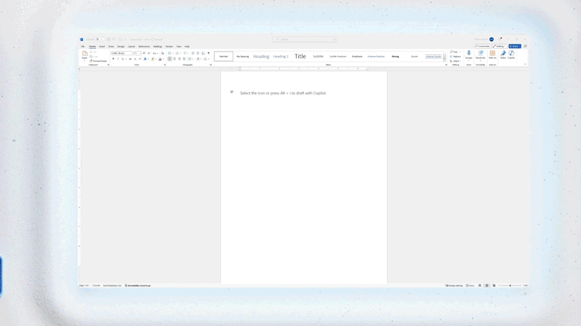
Human resources
HR managers at growth-stage businesses are often tasked with handling recruitment, employee orientation, managing payroll and benefits, providing training and guidance, and resolving disputes. They also need to support current staff for higher employee retention rates. Copilot assists your HR team by providing simplified access to data, improving talent quality, increasing employee satisfaction, and enhancing key performance indicators.
Reduce employee orientation time
Shorten the learning curve for new employees by using Copilot to generate training guides, enhance company handbooks, and send regular check-ins.
Increase support handled by agents
Reduce how much time HR employees spend responding to support tickets and common questions by creating self-service options with agents in Copilot Chat.
Improve issue resolution time
Increase employee retention
Reduce the complexities of everyday tasks and improve internal communications to foster a strong company culture to support employee retention.
Examples Microsoft 365 Copilot prompts for HR:
Can you summarize the current employee engagement survey results, highlighting key areas of concern and potential actions?
Could you create a training schedule for the next quarter? Please include mandatory compliance training and professional development opportunities.
Copilot, please generate a report on the status of recruitment efforts, including open positions, candidate pipeline, and time-to-hire metrics.
Copilot enables HR managers to respond to issues faster, improving employee satisfaction rates and keeping employees focused on their work.
Outcome
  Improved time-to-hire and employee retention
8
BACK
NEXT

Slide 9
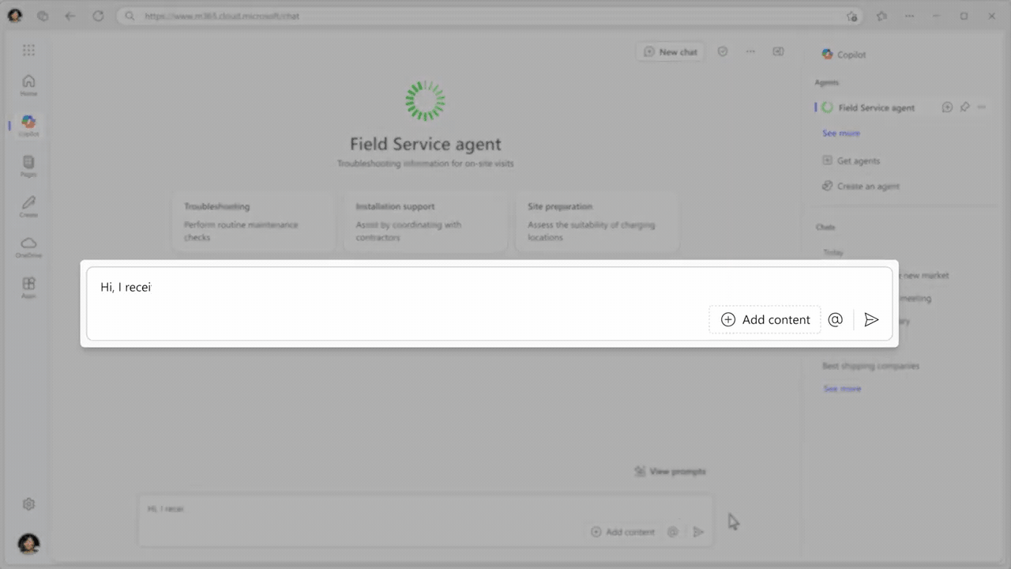
Customer service
Delivering high-quality customer service is essential for growing businesses looking to establish customer loyalty. This starts with customer service reps having a simple tool that provides them with access to the customer, product, and service information they need. However, 43% of customer service reps report being overwhelmed by the number of systems and tools needed to complete their work.⁴
With Copilot embedded directly into customer service reps’ desktops, they can spend less time searching for answers and more time collaborating across departments.
Reduce average resolution time
Customer service reps can use agents in Copilot Chat to quickly find answers, pull customer information, and draft responses, reducing the time it takes to resolve issues and, in turn, improving customer satisfaction rates.
Improve service quality and customer satisfaction scores
Increase customer satisfaction by using Copilot to provide real-time AI assistance for faster issue resolution, generate personalized email responses based on past customer interactions and data, analyze customer feedback, and allow reps to focus on delivering high-quality engagements.
Examples Microsoft 365 Copilot prompts for customer service:
Copilot, can you help me find the right documentation and provide a step-by-step guide to solve the customer’s issue based on their query?
Draft an email reply that includes the case details from the CRM and send a meeting invite to diagnose the customer’s issue.
Review all the service satisfaction responses this week and provide a summary that includes sentiment analysis, the average scores, and the most common issues customers mentioned..
Optimize the number of calls handled by human agents
Develop customer self-service agents for customers using natural language search or automated call systems. These solutions can decrease the number of calls that require a human agent.
4. “The Connected Rep. Deliver better customer service by enabling reps with technology,” Gartner, 2023. GARTNER is a registered trademark and service mark of Gartner, Inc. and/or its affiliates in the US and internationally and is used herein with permission. All rights reserved.
Outcome
  Simplified customer and employee experiences
9
BACK
NEXT

Slide 10


AI has the potential to bring a whole new level of value across your entire business.
[Partner name] can unify your data and get your business AI-ready so you can get the most of your investments across all your business segments. Microsoft 365 Copilot and Copilot Chat are integrated into the apps your team uses daily to combine the most advanced AI models with your business data to provide intelligent, real-time support through agents. As a result, you can boost business efficiency and improve employee productivity and creativity to drive meaningful business impacts.
Get started on your AI transformation journey today by taking advantage of [partner name]’s Microsoft expertise today: [Partner CTA placeholder.]

